Slide 1


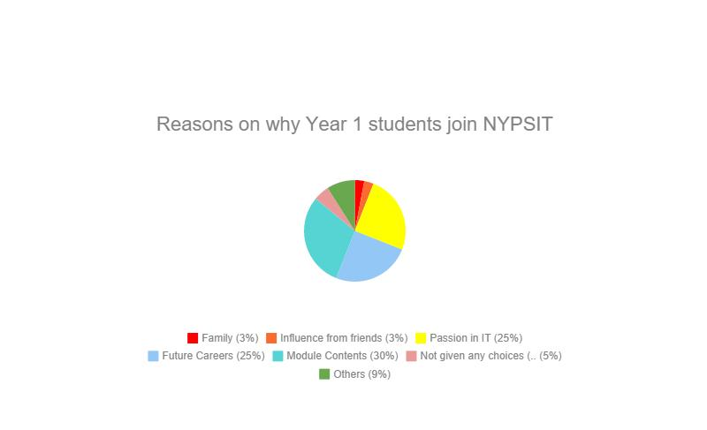
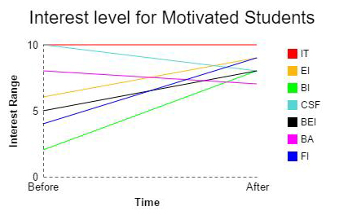
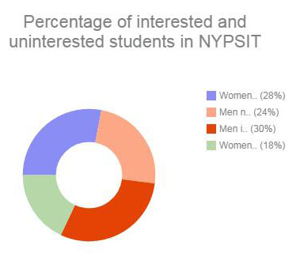
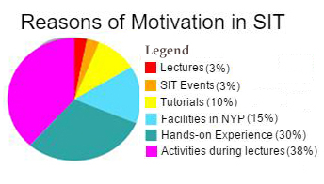
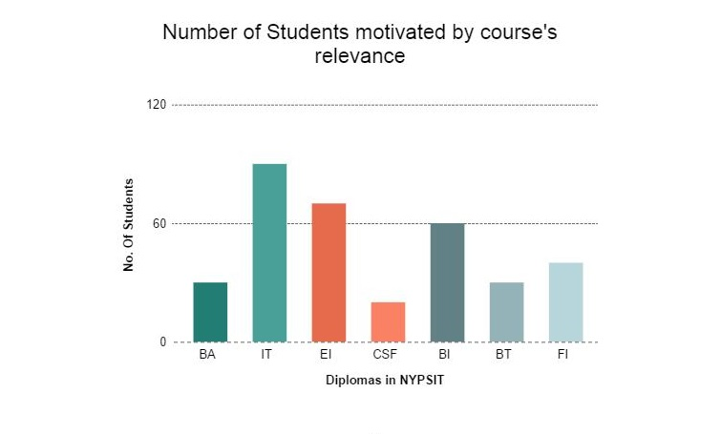
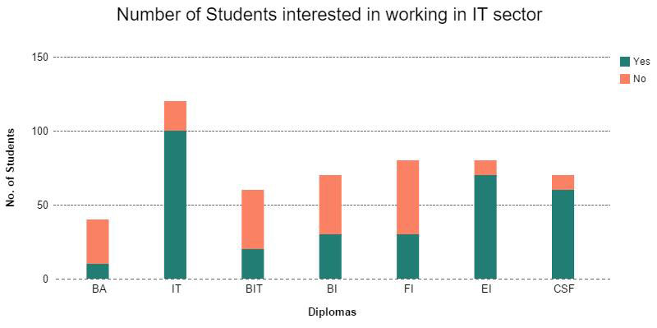
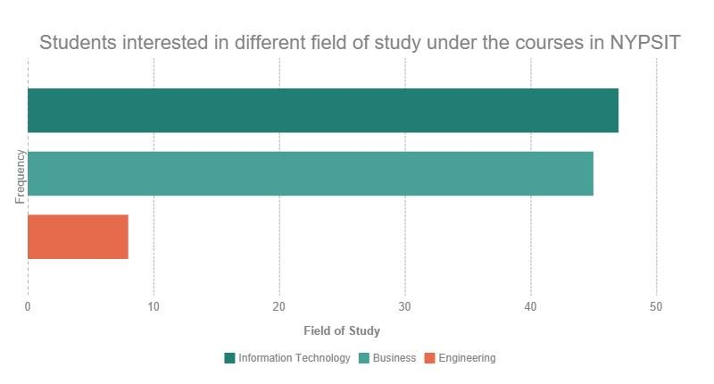
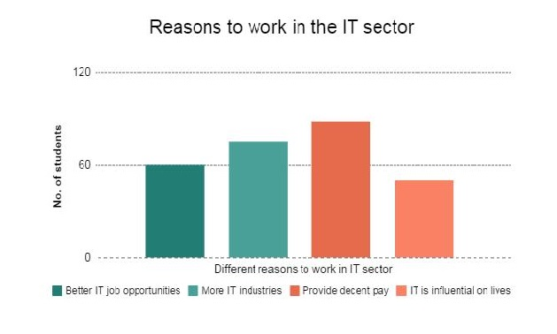
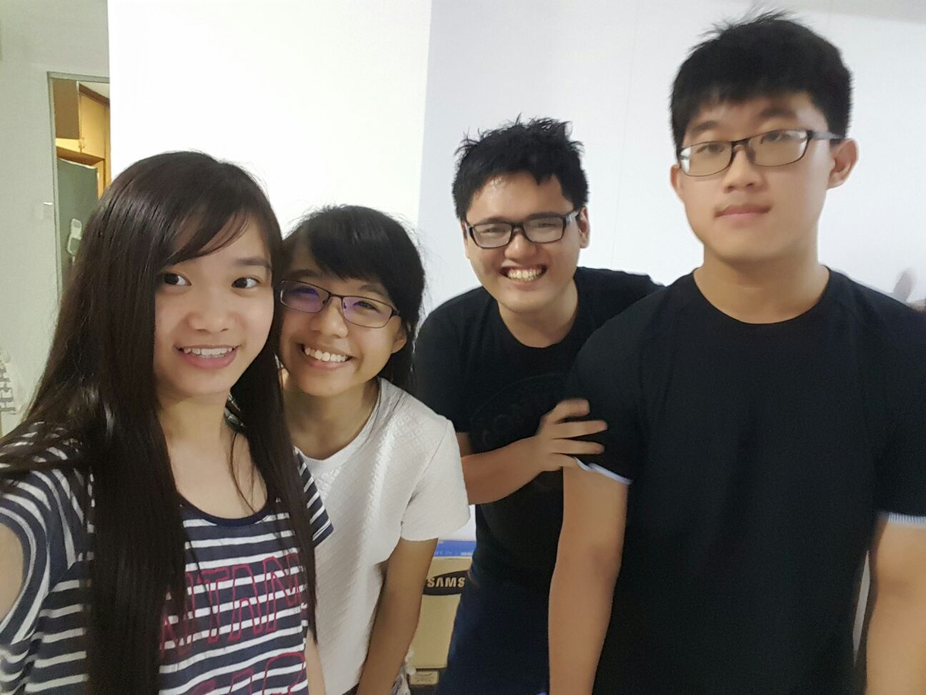
Pure Insanity
Project Objectives: To find out the motivation in NYPSIT Year 1 students and why are they interested in NYPSIT courses.
Interest
Graph 1:
Feature of dashboard: Reasons why
Year 1 students join NYPSIT
Findings discovered: Reasons such as the module contents is what they are interested in and future IT careers, are the major reasons on why they join NYPSIT.
However, our findings find out that the influence from family and friends did not affect their choice to join NYPSIT.
Motivation
Graph 3:
Feature of dashboard: Interested level for motivated and unmotivated students
Findings discovered: For the motivated students, our findings show that CSF and BA interest level decrease slightly after they joined poly. However, BEI, FI and BI increased rapidly.
For the unmotivated students, FI students’ interest level dropped after they joined poly.
However, interest level of students from IT and EI increased slightly after they joined poly.
Graph 4:
Feature of dashboard: Reason of being motivated and unmotivated in SIT
Findings discovered:
Our findings showed that students are feeling motivated due to the activities during lectures and hands on and also feeling unmotivated due to the long hours of the timetable and lectures. It shows that students would prefer more activities and flexible timetable.
Graph 2:
Feature of dashboard: Percentage of males and females that are interested and not interested in IT sector
Findings discovered: 30% of the males are interested in IT and 20% are not as interested in IT. However, 28% of the females are interested in IT and 22% are not interested. This shows that both genders are interested in IT.
Courses Relevance in SIT
Career
Graph 7:
Feature of dashboard: Number of Year 1 students who are interested working in IT sector.
Findings discovered: Across all the diplomas in SIT, diploma in IT, EI and CSF have a higher percentage of students.
Interested working in IT sector. Diploma in FI and BA have the lowest percentage of students working in IT sector.
Graph 5:
Feature of dashboard: Number of students motivated by course’s relevance to their future careers
Findings discovered: Diploma in IT has the highest amount of student that join the course due to course’s relevance, followed by students from EI.
Students from CSF has the least amount of students who are motivated by the course’s relevance.
Graph 6:
Feature of dashboard: Students interested in different field of study under SIT courses
Findings discovered: It shows that students who join IT may be purely interested in IT. However, majority of the students still join SIT as the school offer business + IT courses. Thus, some of them join SIT because they think that the courses are related to business.
Graph 8:
Feature of dashboard: Reasons to work in IT sector
Findings discovered: From the graph, we conclude that most students think that in the field of IT, they are able to earn a decent pay, as compared to other sectors.
Rarely, people would join IT course because they thought that IT is influential to their everyday’s lives.
Team Details:
Tan Jun Long (151176T)
Aw Aun Yeow (152899E)
Chong Yan Qing (154466H)
Gan Wan Tian Mabel (151477X)

